Slide 1
Revision Guide
Module 3 – Energy and rates

Slide 2
Enthalpy changes

Slide 3
What you need to know…
Explain ENDOTHERMIC and EXOTHERMIC reactions using energy level diagrams.
Draw accurate enthalpy profiles illustrating the enthalpy change of reaction and the activation energy.

Slide 4
Change in energy
Chemical reactants have a certain amount of chemical energy stored within them.
When the reaction has taken place they have either more or less energy stored within them than before.

Slide 5
Definitions
An exothermic chemical reaction where the products have less energy than the reactants. Energy is given out to the surroundings (temperature goes up).
An endothermic chemical reaction is where the products have more energy than the reactants. Energy is taken in from the surroundings (temperature goes down).

Slide 6
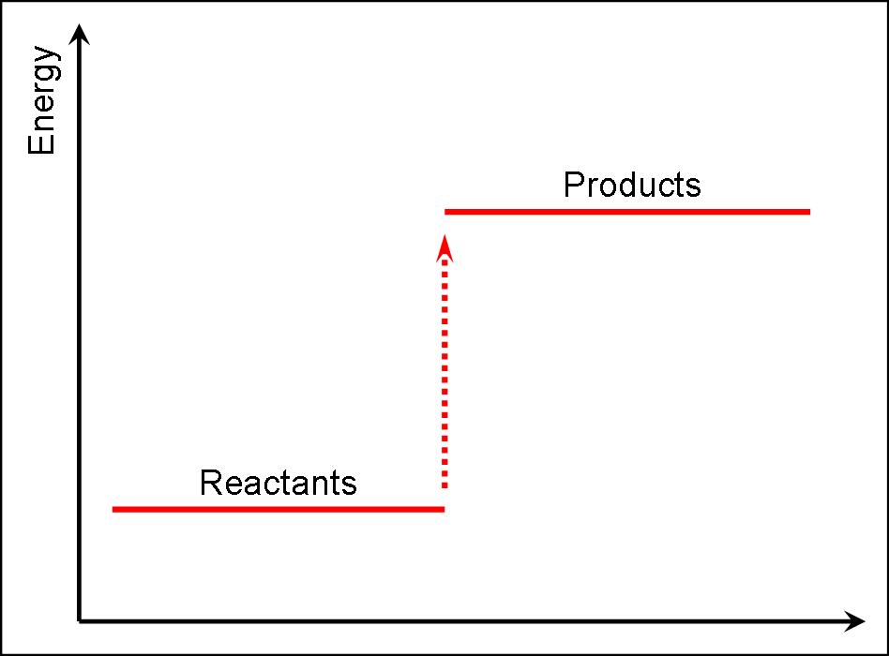
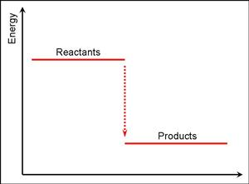
Energy level diagrams
Endothermic Exothermic
Heat taken in
Heat given out
Energy level of products is higher than reactants so heat taken in.
Energy level of products is lower than reactants so heat given out.

Slide 7
Question

Slide 8
Answer

Slide 9
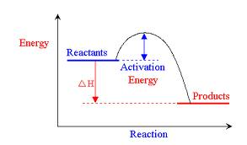
Enthalpy profile

Slide 10
What you need to know…
Recall that energy is needed to break chemical bonds and energy is given out when chemical bonds form
Identify which bonds are broken and which are made when a chemical reaction takes place. Define and use the term average bond enthalpy.
Use data on the energy needed to break covalent bonds to estimate the overall enthalpy change of reaction.

Slide 11
Definitions
Activation energy is the energy needed to start a reaction by breaking chemical bonds in the reactants.
Average bond enthalpy is the average enthalpy change that takes place when breaking by homolytic fission 1 mol of a given type of bond in the molecules of a gaseous species.

Slide 12
Why is a reaction exothermic or endothermic? LEARN THIS!!!!
Breaking bonds is endothermic and requires energy.
Making bonds is exothermic and releases energy.
If the energy released making bonds is greater than energy needed to break bonds then the reaction is exothermic.
If the energy released making bonds is less than that needed to break bonds then the reaction is endothermic.

Slide 13
What happens when the reaction gets the activation energy?
C
H
H
H
H
Bond
Breaking
O
O
O
O
Bond
Forming
H
O
Energy in chemicals
O
C
O
O
H
O
H
H
H
H
O
O
C
O
H
H
Progress of reaction

Slide 14
Using bond enthalpies
By using the energy that it takes to break/make a particular bond we can work out the overall enthalpy/energy change for the reaction.
Sum (bonds broken) – Sum (bonds made) = Energy change
ΔH = (bond enthalpies of bonds broken) - (bond enthalpies of bonds made)

Slide 15
Bond enthalpies
Bond | Bond enthalpy (kJ) | Bond | Bond enthalpy (kJ)
C—H | 435 | Cl—Cl | 243
C—C | 348 | C—Cl | 346
H—H | 436 | H—Cl | 452
H—O | 463 | O=O | 498
 |  | C=O | 804
 |  | C=C | 614
Definition
Average bond enthalpy is the average enthalpy change that takes place when breaking by homolytic fission 1 mol of a given type of bond in the molecules of a gaseous species.

Slide 16
Examination question

Slide 17
Mark scheme

Slide 18
Calorimetry

Slide 19
You need to be able to…
Perform experiment to determine the temperature change for a chemical reaction using a graphical method
Calculate enthalpy changes directly from experimental results given in examination questions
Use the relationship ΔE = mcΔT to calculate the enthalpy change in an unfamiliar example.

Slide 20
Energy change
We can relate the energy change in a reaction (ΔE) to the change in temperature of the surroundings.
ΔE = mcΔT
m = mass of the surroundings
C= specific heat capacity of the surroundings
ΔT = change in temperature of the surroundings.

Slide 21
What are the surroundings?
The surroundings are where the thermometer is and what is heated up/cooled down as a result of the reaction.
In solution this is easy because you put the thermometer in the water and measure the temperature change.
If the experiment is not in solution you can use a “calorimeter” which is a container of water that is warmed by the reaction.

Slide 22
A calorimeter

Slide 23
Specific heat capacity
The specific heat capacity, c, is the energy required to raise the temperature of 1g of a substance by 1°C.
It has units of JK⁻¹g⁻¹
When we are conducting experiments we usually heat up some water and so the specific heat capacity we use is 4.18 JK⁻¹g⁻¹

Slide 24
Past paper question
Attempt the following past paper questions based on calculating enthalpy changes using ΔE=mcΔT

Slide 25
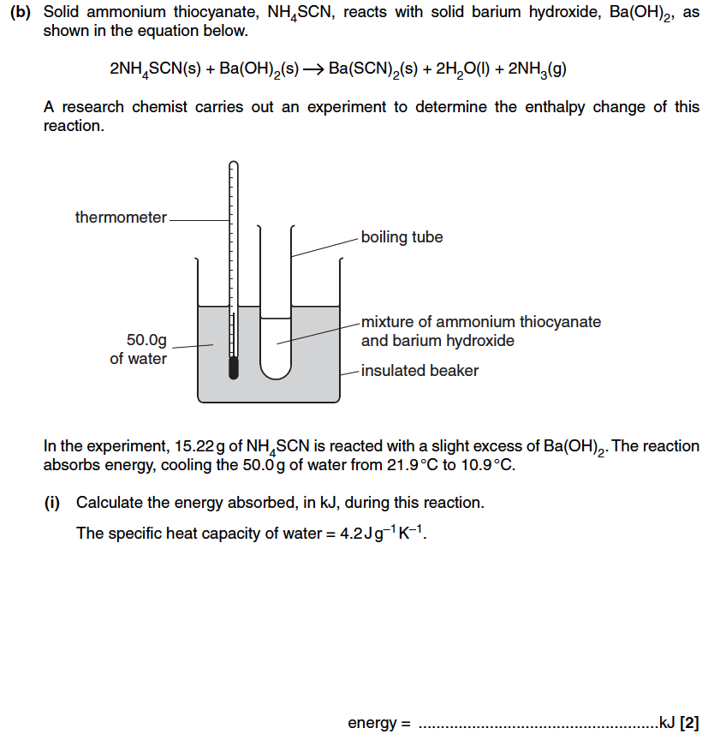

Slide 26
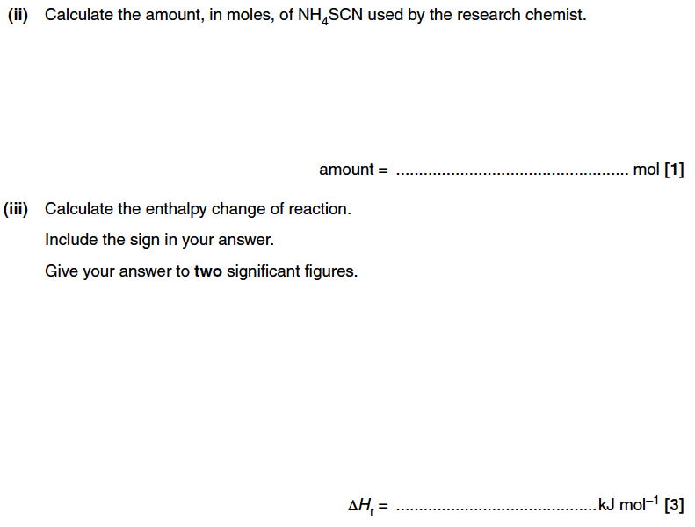

Slide 27
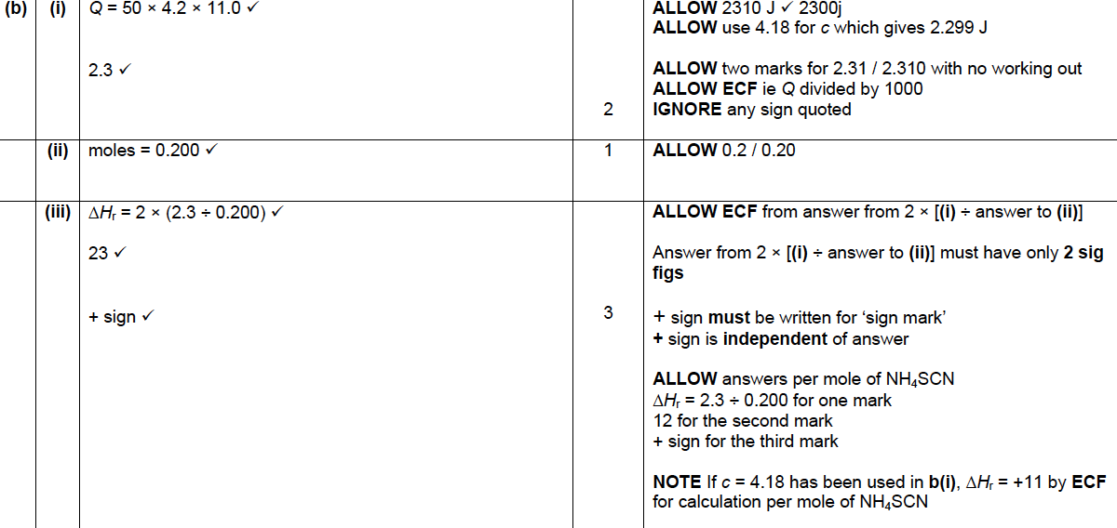

Slide 28
Calorimetry

Slide 29
How does calorimetry work?
A known volume of cold water is measured into the beaker/can
The starting temperature of the water is recorded
The water is heated using the flame from the burning fuel
The final temperature of the water is recorded
The spirit burner containing the fuel is weighed before and after the experiment.

Slide 30
Calculations
The amount of energy transferred from the burning fuel to the water (the surroundings) in the calorimeter can be calculated if you know:
the mass of water heated
the temperature rise
AfL – can you remember the equation required?

Slide 31
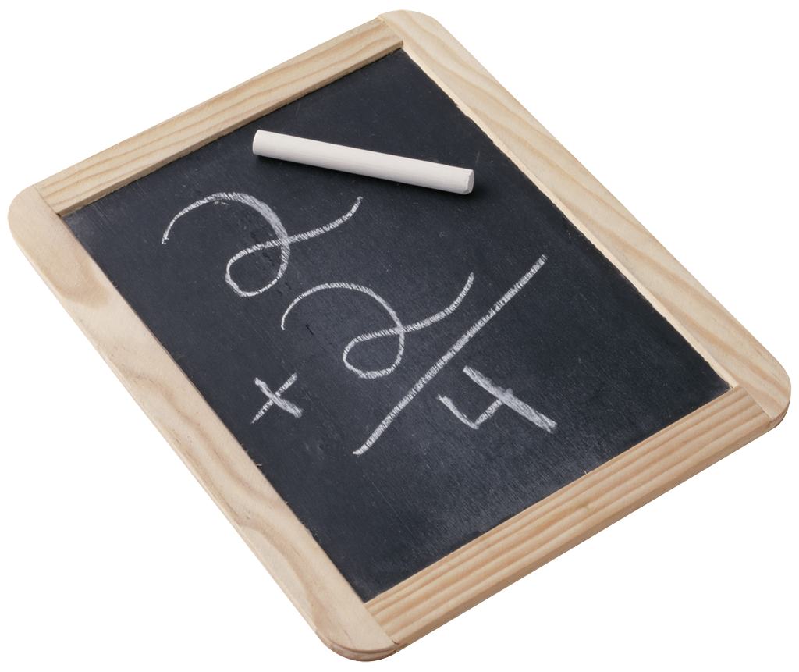
Calculations
ΔE = mcΔT
Energy transferred (joules, J) = mass of water heated × 4.2 × temperature rise

Slide 32
Energy per gram of fuel
You can compare fuels by measuring the mass of fuel burned in the experiment. The best fuel is likely to release the most energy per gram of fuel. This is worked out using:
Energy released (J/g of fuel) = Energy transferred to water (J) ÷ Mass of fuel burned (g)
To work out J/mol then multiply the J/g by the Mr

Slide 33
Errors
Why do experimental values for ΔHc deviate from their theoretical counterparts.
Energy lost to the surroundings
Incomplete combustion
Conditions which are not standard (ie not 298K and 1atm pressure)

Slide 34
Examination questions

Slide 36
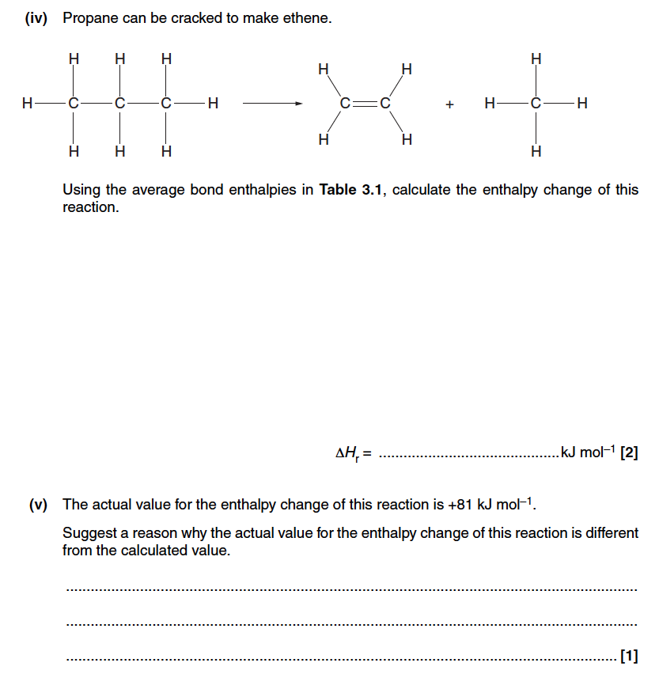

Slide 37
Mark scheme

Slide 38
Examination question

Slide 40
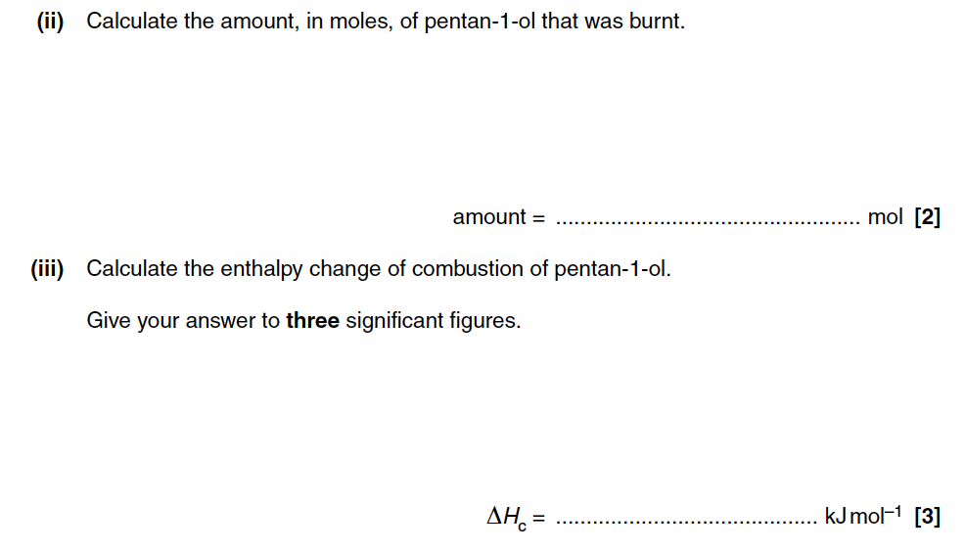

Slide 41
Mark scheme

Slide 42
Past paper question

Slide 44
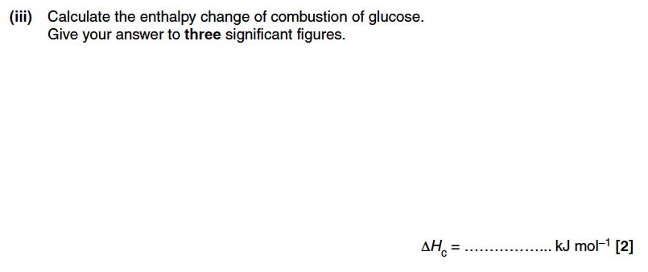

Slide 45
Mark scheme

Slide 46
Standard enthalpy changes

Slide 47
You need to be able to…
Recall and use the term STANDARD CONDITIONS
Define the terms standard enthalpy change of REACTION, FORMATION AND COMBUSTION.
Calculate and write chemical equations for the standard enthalpy changes

Slide 48
Enthalpy of reaction
The overall energy change is referred to as the enthalpy of reaction
If the conditions are standard conditions then we call the energy change the
Standard enthalpy of reaction, ΔH_{r}
Φ

Slide 49
Standard conditions?
LEARN – quoting these is worth marks on the exam…
Standard conditions are a pressure of 100kPa, 298K (25°C) and a concentration of 1.0 M (for reactions with aqueous solutions).
Standard state is the physical state of a substance under standard conditions
eg magnesium has the standard state Mg (s), hydrogen has the standard state H₂(g) and water has the standard state H₂O (l)

Slide 50
Definitions – part 1
Φ
The standard enthalpy change of reaction ΔH_{r} is the enthalpy change that accompanies a reaction in the molar quantities expressed in a chemical equation under standard conditions, all reactants and products being in their standard states.
H₂(g) + ½ O₂ (g) → H₂O(l) ΔH_{r} = -286kJmol⁻¹

Slide 51
AfL Quiz – Part 1 ΔH_{r}
Two enthalpy changes of reaction are shown below:
N₂(g) + 3H₂(g) → 2NH₃ (g) ΔH = -92 kJmol⁻¹
N₂O₄ (g) → 2NO₂ (g) ΔH = +58 kJmol-¹
What is the enthalpy change of reaction for:
½N₂(g) + 1½ H₂(g) → NH₃ (g) ΔH = _____ kJmol⁻¹
½N₂O₄ (g) → NO₂ (g) ΔH = ______ kJmol-¹

Slide 52
AfL Quiz – Part 1 ΔH_{r}
Two enthalpy changes of reaction are shown below:
N₂(g) + 3H₂(g) → 2NH₃ (g) ΔH = -92 kJmol⁻¹
N₂O₄ (g) → 2NO₂ (g) ΔH = +58 kJmol-¹
What is the enthalpy change of reaction for:
½N₂(g) + 1½ H₂(g) → NH₃ (g) ΔH = -46 kJmol⁻¹
½N₂O₄ (g) → NO₂ (g) ΔH = +29 kJmol-¹

Slide 53
Definitions – part 2
Φ
The standard enthalpy change of combustion ΔH_{c} is the enthalpy change that takes place when one mole of a substance reacts completely with oxygen under standard conditions, all reactants and products being in their standard states.
C₂H₆(g) + 3½ O₂ (g) → 2CO₂(g) + 3H₂O(l)
ΔH_{c} = -1560 kJmol⁻¹
Φ

Slide 54
AfL Quiz part 2- ΔH_{c}
Write equations for the change that occurs during the enthalpy change of combustion for each of the following compounds
CH₄(g)
C₃H₈(g)
CS₂(l)
CH₃OH(l)
C₂H₅OH(l)

Slide 55
AfL Quiz part 2- ΔH_{c}
Write equations for the change that occurs during the enthalpy change of combustion for each of the following compounds
CH₄(g) + 2O₂(g)→ CO₂(g) + 2H₂O(l)
C₃H₈(g) + 5O₂(g)→ 3CO₂(g) + 4H₂O(l)
CS₂(l) + 3O₂(g) → CO₂(g) + 2SO₂(g)
CH₃OH(l) + 1½ O₂(g)→ CO₂(g) + 2H₂O(l)
C₂H₅OH(l) + 3O₂(g)→ 2CO₂(g) + 3H₂O(l)

Slide 56
Definitions – part 3
Φ
The standard enthalpy change of formation ΔH_{f} is the enthalpy change that takes place when one mole of a compound is formed from its constituent elements in their standard states under standard conditions.
H₂(g) + ½ O₂ (g) → H₂O(l) ΔH_{f} = -286kJmol⁻¹
ΔH_{f} = -286 kJmol⁻¹
Φ
Φ

Slide 57
AfL Quiz part 3- ΔH_{f}
Write equations for the change that occurs during the enthalpy change of formation for each of the following compounds.
C₂H₄(g)
C₂H₆(g)
C₂H₅OH(l)
CaO(s)
Al₂O₃(s)

Slide 58
AfL Quiz part 3- ΔH_{f}
Write equations for the change that occurs during the enthalpy change of formation for each of the following compounds.
2C(s) + 2H₂(g) → C₂H₄(g)
2C(s) + 3H₂(g) → C₂H₆(g)
2C(s) + 3H₂(g) + ½ O₂(g) → C₂H₅OH(l)
Ca(s) + ½ O₂(g) → CaO(s)
2Al(s) + 1 ½ O₂(g) → Al₂O₃(s)

Slide 59
Quick tips
Remember that:
for ΔH_{r} you are using the moles given in the equation
for ΔH_{c} you are burning 1 mole of fuel with however much oxygen it takes
for ΔH_{f} you are forming 1 mole of compound from however much of its elements are required
ΔH_{f} for an element is 0 kJmol⁻¹

Slide 60
Plenary - Exam question

Slide 61
Mark scheme

Slide 62
Hess’ law and enthalpy cycles

Slide 63
You need to be able to…
Recall Hess’ Law
Interpret an enthalpy cycle using Hess’ Law
Construct an enthalpy cycle and use it to calculate an enthalpy change of reaction from enthalpy changes of combustion
Construct an enthalpy cycle and use it to calculate enthalpy changes of reaction from enthalpy changes of formation.
Construct and use an unfamiliar enthalpy cycle to determine an enthalpy change of reaction.

Slide 64
Test your understanding
What are standard conditions?
Define ΔH_{c}
Define ΔH_{f}
Define ΔH_{r}
Describe the following equations as ΔH_{c}, ΔH_{r} or ΔH_{f}
3C(s) + 4H₂(g) →C₃H₈(g)
C₃H₈(g) + 5O₂(g) → 3CO₂(g) + 4H₂O(l)
C₂H₄(g) + H₂(g) → C₂H₆(g)
2C₂H₆(l) + 7O₂(g) → 4CO₂(g) + 6H₂O(l)
Write the equation for ΔHc for
H₂
CH₃OH
C

Slide 65
Answers
Standard conditions are 298K, 100 kPa and 1M for solutions. All substances should be in their standard states
The standard enthalpy change of combustion ΔH_{c} is the enthalpy change that takes place when one mole of a substance reacts completely with oxygen under standard conditions, all reactants and products being in their standard states.
The standard enthalpy change of formation ΔH_{f} is the enthalpy change that takes place when one mole of a compound is formed from its constituent elements in their standard states under standard conditions.
The standard enthalpy change of reaction ΔH_{r} is the enthalpy change that accompanies a reaction in the molar quantities expressed in a chemical equation under standard conditions, all reactants and products being in their standard states.

Slide 66
Answers
Describe the following equations as ΔH_{c}, ΔH_{r} or ΔH_{f}
3C(s) + 4H₂(g) →C₃H₈(g) ΔH_{f}
C₃H₈(g) + 5O₂(g) → 3CO₂(g) + 4H₂O(l) ΔH_{c}
C₂H₄(g) + H₂(g) → C₂H₆(g) ΔH_{r}
2C₂H₆(l) + 7O₂(g) → 4CO₂(g) + 6H₂O(l) ΔH_{r} (because 2mols are shown to be burnt)
Write the equation for ΔH_{c} for
H₂(g) + ½ O₂(g) → H₂O(l)
CH₃OH(l) + O₂(g) → CO₂(g) + H₂O(l)
C(s) + O₂(g) → CO₂(g)

Slide 67
Problems with measuring enthalpy changes directly
There may be:
a high activation energy
a slow reaction rate
more than one reaction taking place
Take for example 3C(s) + 4H₂(g) → C₃H₈(g)
This is virtually impossible to measure directly - think of the number of compounds of hydrogen and carbon that could form!

Slide 68
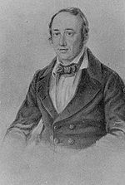
Hess’ Law
Hess’ law states that, if a reaction can take place by more than one route and the initial and final conditions are the same, the total enthalpy change is the same.
A
Reactants
Products
B
C
Intermediate
ΔH_{(Route A)} = ΔH_{(Route B)} – ΔH_{(Route C)}
Draw an enthalpy cycle – then if you follow the direction of an arrow then ADD. If opposite to the direction of the arrow then SUBTRACT.

Slide 69
Using combustion data
The combustion of reactants and combustion of products is a useful way to complete the cycle in a way that can be experimentally determined.
ΔH_{r}
Reactants
Products
Σ ΔH_{c(reactants)}
Σ ΔH_{c(products)}
Combustion products
ΔH_{r} = Σ ΔH_{c(reactants)} – Σ ΔH_{c(products)}
Draw an enthalpy cycle – then if you follow the direction of an arrow then ADD. If opposite to the direction of the arrow then SUBTRACT.

Slide 70
Example
You are provided with the following enthalpy changes of combustion
Determine the enthalpy change for the following reaction:
4C(s) + 5H₂(g) → C₄H₁₀(g)
Substance | C(s) | H₂(g) | C₄H₁₀(g) | C₂H₅OH(l)
ΔH_{c} / kJmol⁻¹ | -394 | -286 | -2877 | -1367

Slide 71
Substance | C(s) | H₂(g) | C₄H₁₀(g) | C₂H₅OH(l)
ΔH_{c} / kJmol⁻¹ | -394 | -286 | -2877 | -1367
ΔH_{f}
4C(s) + 5H₂ (g)
C₄H₁₀(g)
4ΔH_{c}(C)+ 5ΔH_{c}(H₂)
ΔH_{c}(C₄H₁₀)
Combustion products
ΔH_{f} = (4 x -394) + (5 x -286) – (-2877) = -129 kJmol⁻¹

Slide 72
Example
You are provided with the following enthalpy changes of combustion
Determine the enthalpy change for the following reaction:
2C(s) + 3H₂(g) + ½O₂(g) → C₂H₅OH(l)
Substance | C(s) | H₂(g) | C₄H₁₀(g) | C₂H₅OH(l)
ΔH_{c} / kJmol⁻¹ | -394 | -286 | -2877 | -1367

Slide 73
Substance | C(s) | H₂(g) | C₄H₁₀(g) | C₂H₅OH(l)
ΔH_{c} / kJmol⁻¹ | -394 | -286 | -2877 | -1367
ΔH_{r}
2C(s) + 3H₂ (g) + ½ O₂(g)
C₂H₅OH(l)
2ΔH_{c}(C)+ 3ΔH_{c}(H₂)
ΔH_{c}(C₂H₅OH)
Combustion products
ΔHr = (2 x -394) + (3 x -286) – (-1367) = -279 kJmol⁻¹

Slide 74
Examination question

Slide 75
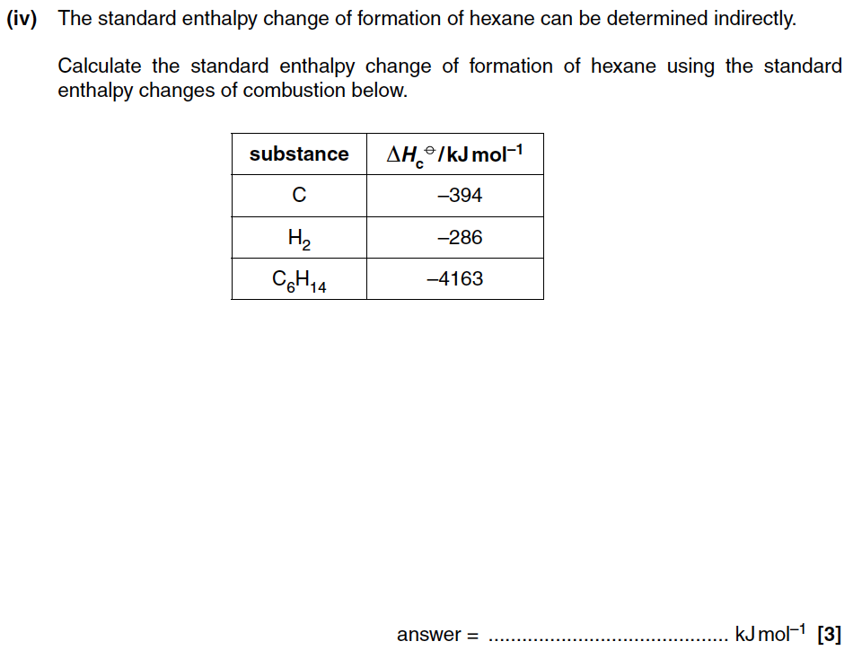

Slide 76
Mark scheme

Slide 77
Mark scheme

Slide 78
Using ΔH_{f}
As with ΔH_{c} many ΔHf values have also been measured and can be looked up in tables
ΔH_{r}
Reactants
Products
Σ ΔH_{f(reactants)}
Σ ΔH_{f(products)}
Elements
ΔH_{r} = - Σ ΔH_{f(reactants)} + Σ ΔH_{f(products)}
Draw an enthalpy cycle – then if you follow the direction of an arrow then ADD. If opposite to the direction of the arrow then SUBTRACT.

Slide 79
Example
You are provided with the following enthalpy changes of formation
Determine the enthalpy change for the following reaction:
2NO (g) + O₂(g) → 2NO₂(g)
Substance | NO₂(g) | NH₃(g) | NO(g) | H₂O(l) | HNO₃(l)
ΔH_{f} / kJmol⁻¹ | 33 | -46 | 90 | -286 | -174

Slide 80
Substance | NO₂(g) | NH₃(g) | NO(g) | H₂O(l) | HNO₃(l)
ΔH_{f} / kJmol⁻¹ | 33 | -46 | 90 | -286 | -174
ΔH_{r}
2NO(g) + O₂ (g)
2NO₂(g)
2ΔH_{f}(NO)
2ΔH_{f}(NO₂)
Elements
ΔH_{r} = -(2 x 90) + (2 x 33) = -114 kJmol⁻¹

Slide 81
Example
You are provided with the following enthalpy changes of formation
Determine the enthalpy change for the following reaction:
4NH₃ (g) + 5O₂(g) → 4NO(g) + 6H₂O(l)
Substance | NO₂(g) | NH₃(g) | NO(g) | H₂O(l) | HNO₃(l)
ΔH_{f} / kJmol⁻¹ | 33 | -46 | 90 | -286 | -174

Slide 82
Substance | NO₂(g) | NH₃(g) | NO(g) | H₂O(l) | HNO₃(l)
ΔH_{f} / kJmol⁻¹ | 33 | -46 | 90 | -286 | -174
ΔH_{r}
4NH₃(g) + 5O₂ (g)
4NO(g) + 6H₂O(l)
4ΔH_{f}(NH₃)
4ΔH_{f}(NO) + 6ΔH_{f}(H₂O)
Elements
ΔH_{r} = -(4 x -46) + (4 x 90) + (6 x -286) = -1172 kJmol⁻¹

Slide 83
Example
You are provided with the following enthalpy changes of formation
Determine the enthalpy change for the following reaction:
2H₂O (l) + 4NO₂(g) + O₂(g) → 4HNO₃(l)
Substance | NO₂(g) | NH₃(g) | NO(g) | H₂O(l) | HNO₃(l)
ΔH_{f} / kJmol⁻¹ | 33 | -46 | 90 | -286 | -174

Slide 84
Substance | NO₂(g) | NH₃(g) | NO(g) | H₂O(l) | HNO₃(l)
ΔH_{f} / kJmol⁻¹ | 33 | -46 | 90 | -286 | -174
ΔH_{r}
2H₂O(l) + 4NO₂ (g) + O₂(g)
4HNO₃(l)
2ΔH_{f}(H₂O) + 4ΔH_{f}(NO₂)
4ΔH_{f}(HNO₃)
Elements
ΔH_{r} = -(2 x -286) - (4 x 33) + (4 x -174) = -256 kJmol⁻¹

Slide 85
Other enthalpy cycles
In your AS course you have to be able to construct and use cycles that use combustion and formation data.
The same principles can be applied to any energy cycle provided it is constructed correctly.
Following the arrows ADD, opposite to the arrows SUBTRACT and you can’t go wrong.

Slide 86
Question 1

Slide 87
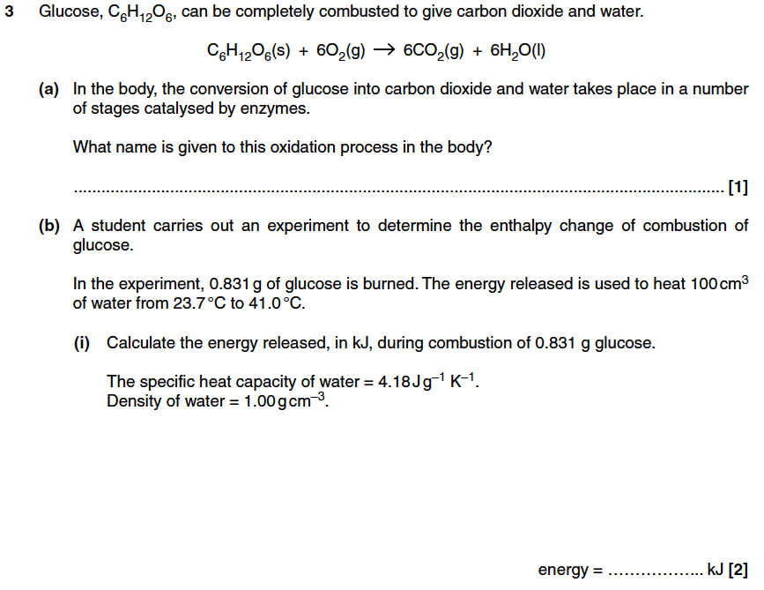

Slide 88
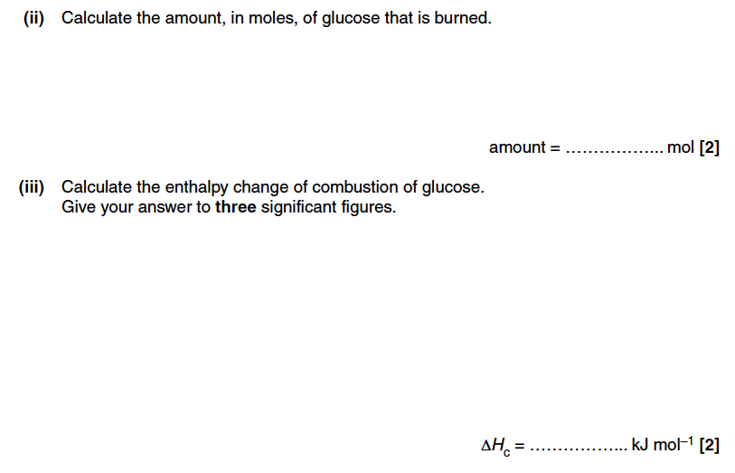

Slide 89
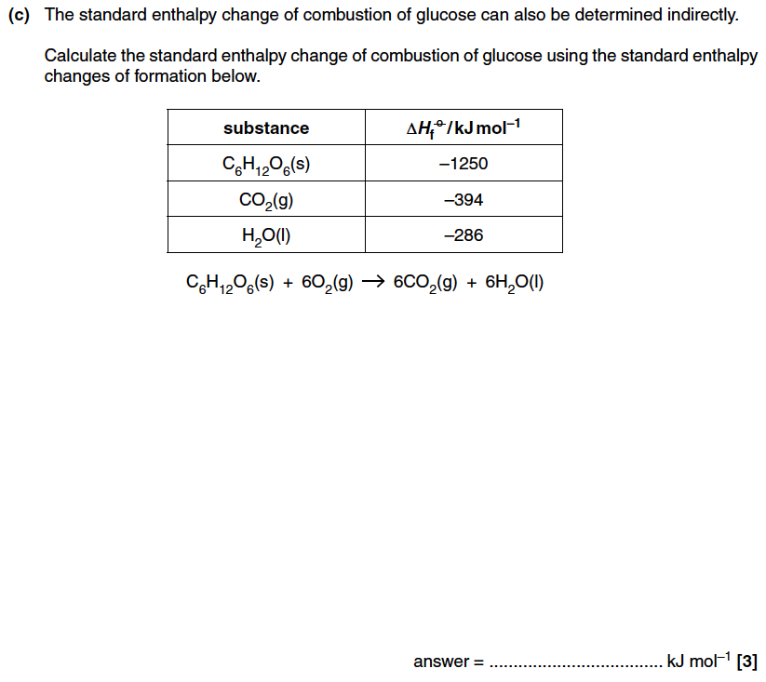

Slide 90
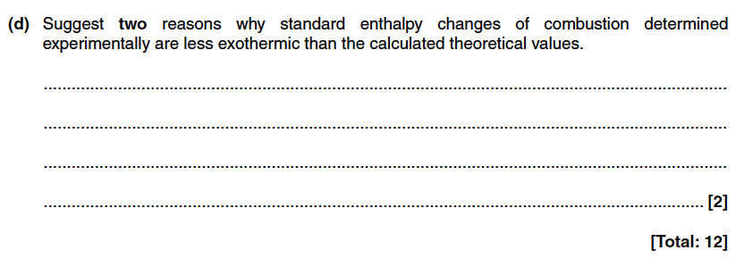

Slide 91
Question 2

Slide 92
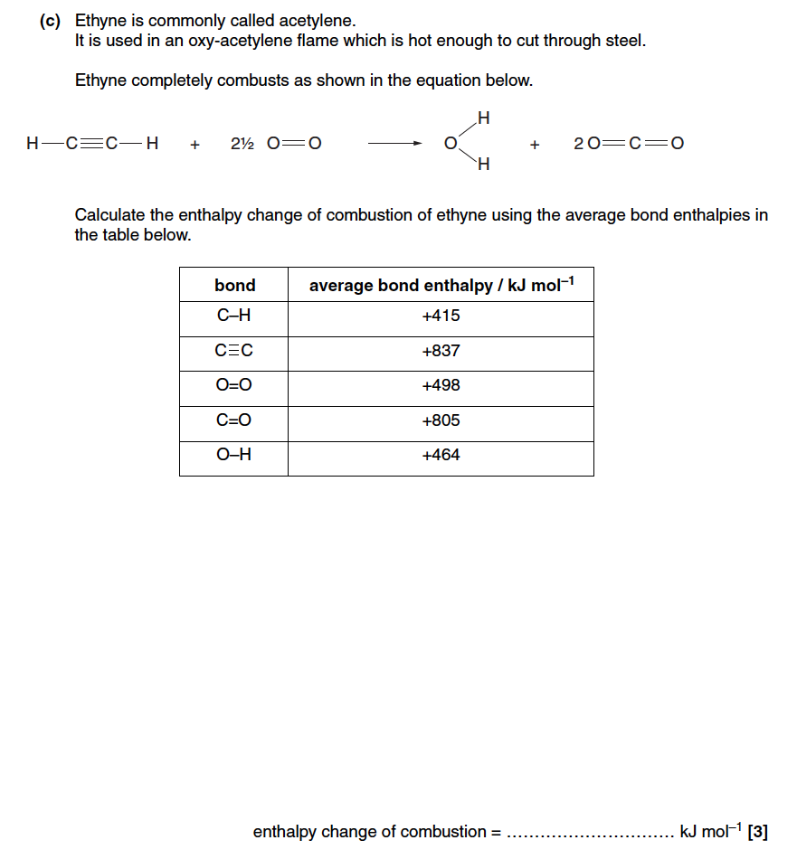

Slide 93
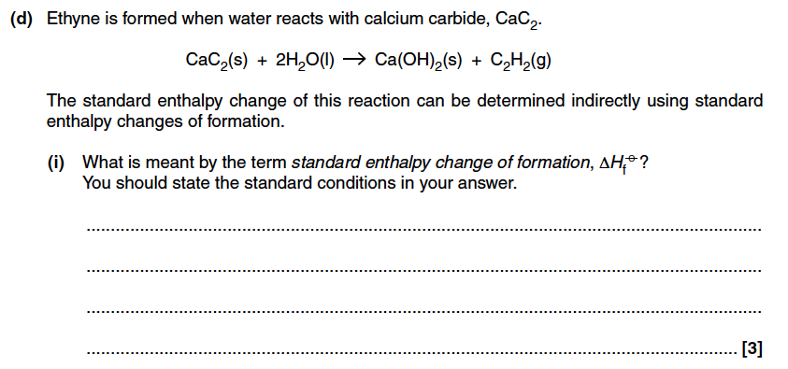

Slide 94
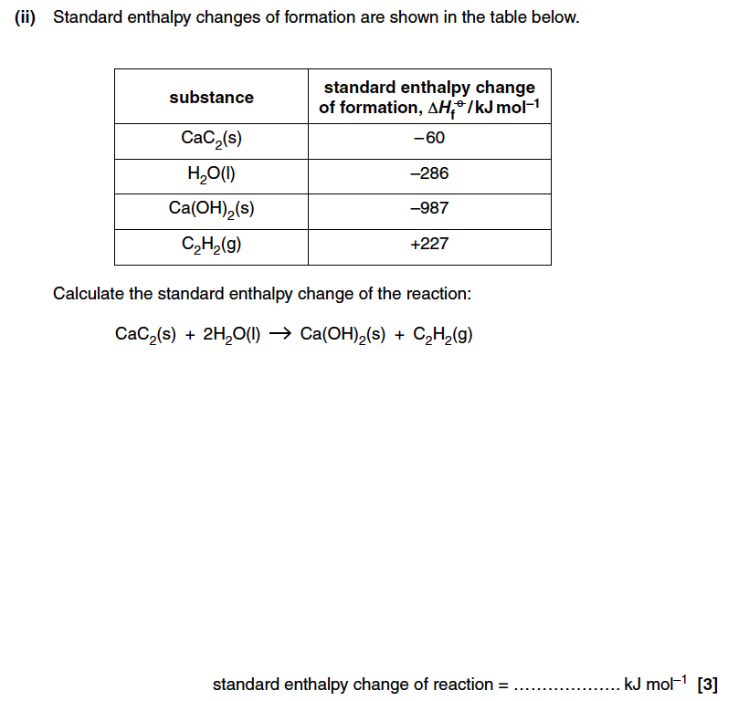

Slide 95
Mark schemes
Cover until you have answered

Slide 96
Mark scheme Q1 – cover until you have answered

Slide 97
Mark scheme

Slide 98
Mark scheme Q2

Slide 99
Mark scheme

Slide 100
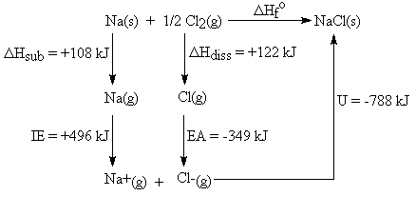
Challenge question
Use this cycle to predict the unknown ΔH_{f} NaCl

Slide 101
Answer

