Slide 1
Revision Guide – Unit 2
Module 1 – Organic Chemistry

Slide 2
Types of formulae

Slide 3
Types of formula you need to know
Empirical
Molecular
Displayed
Structural
Skeletal
General

Slide 4
Definitions
empirical formula - the simplest whole number ratio of atoms of each element present in a compound edg CH₂
molecular formula - the actual number of atoms of each element in a molecule,
general formula - the simplest algebraic formula of a member of a homologous series, ie for an alkane: C_{n}H_{2n+2},
structural formula as the minimal detail that shows the arrangement of atoms in a molecule
displayed formula as the relative positioning of atoms and the bonds between them, all bonds shown
skeletal formula as the simplified organic formula, shown by removing hydrogen atoms from alkyl chains,

Slide 5
Molecular and empirical formulae
There are many ways of representing organic compounds by using different formulae.
The molecular formula of a compound shows the number of each type of atom present in one molecule of the compound.
Molecular formula
Empirical formula
C₂H₆
CH₃
The empirical formula of a compound shows the simplest ratio of the atoms present.
C₆H₁₂O₆
CH₂O
C₂H₄O₂
CH₂O
Neither the molecular nor empirical formula gives information about the structure of a molecule.

Slide 6
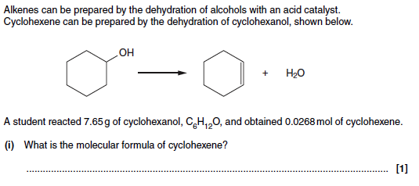
Exam question

Slide 7
Mark scheme
C₆H₁₀

Slide 8
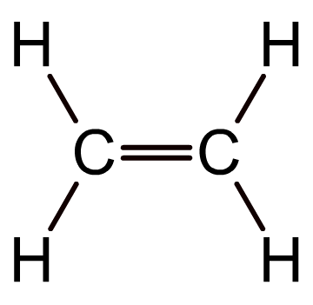
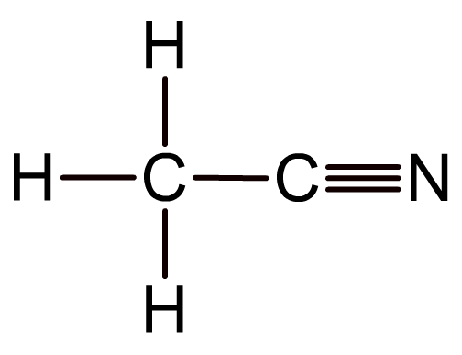
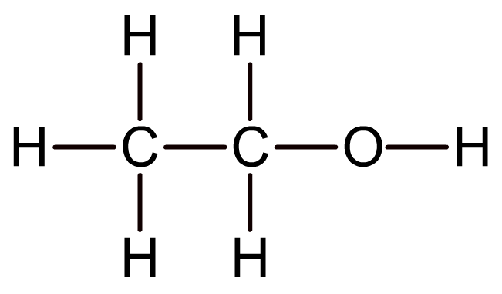
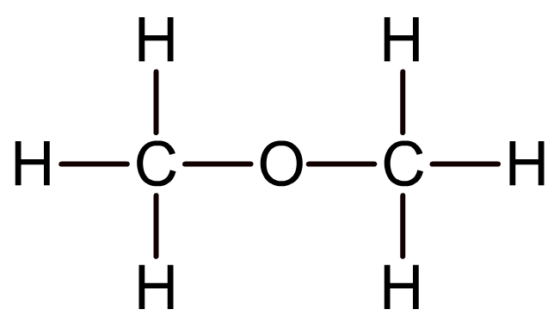
Displayed formula of organic compounds
The displayed formula of a compound shows the arrangement of atoms in a molecule, as well as all the bonds.
Single bonds are represented by a single line, double bonds with two lines and triple bonds by three lines.
The displayed formula can show the different structures of compounds with the same molecular formulae.
ethanol (C₂H₆O)
methoxymethane (C₂H₆O)

Slide 9
Structural formula of organic compounds
The structural formula of a compound shows how the atoms are arranged in a molecule and, in particular, shows which functional groups are present.
Unlike displayed formulae, structural formulae do not show single bonds, although double/triple bonds may be shown.
CH₃CHClCH₃
H₂C=CH₂
CH₃C≡N
2-chloropropane
ethene
ethanenitrile

Slide 10
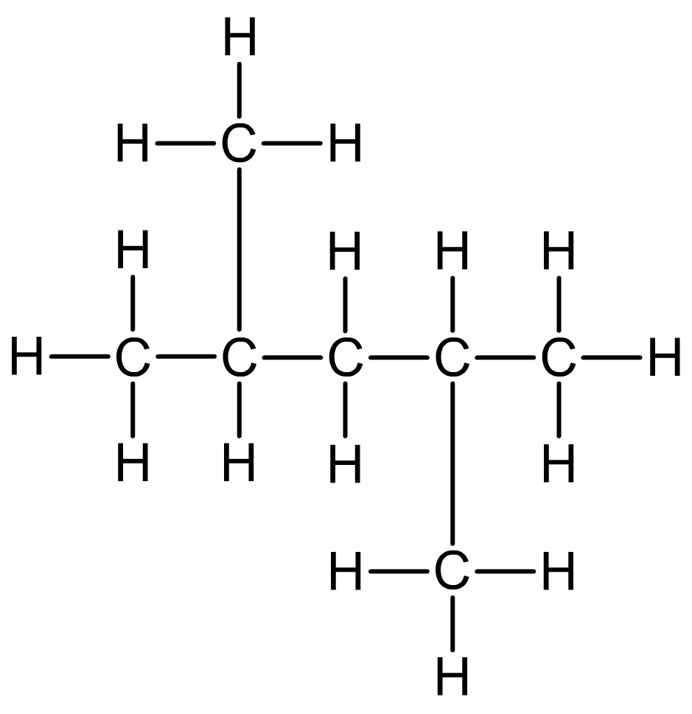
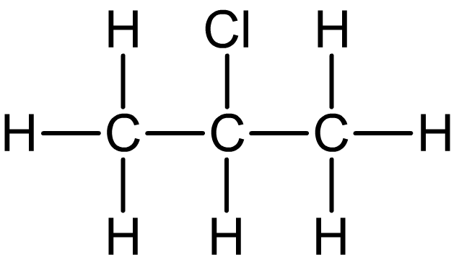
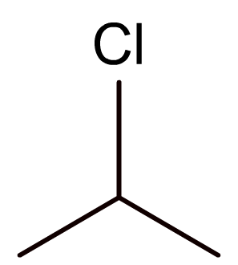
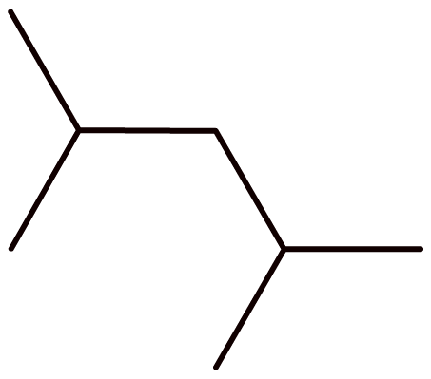
Skeletal formula of organic compounds
The skeletal formula of a compound shows the bonds between carbon atoms, but not the atoms themselves. Hydrogen atoms are also omitted, but other atoms are shown.

Slide 11
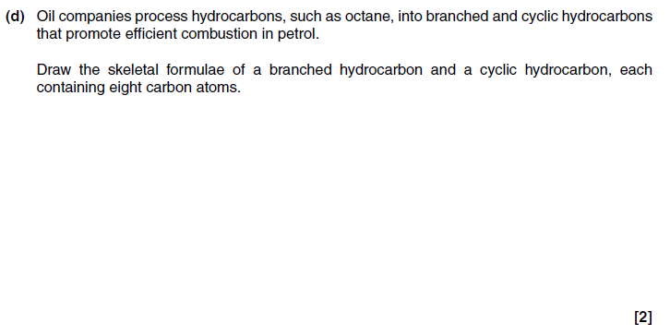
Examination question

Slide 12
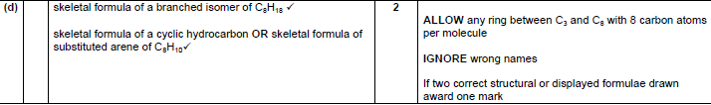
Mark scheme

Slide 13
Definitions
homologous series is a series of organic compounds having the same functional group but with each successive member differing by CH₂,
functional group is a group of atoms responsible for the characteristic reactions of a compound

Slide 14
You need to know
How to use the general formula of a homologous series to predict the formula of any member of the series;
How to create the general formula of a homologous series
Be able to state the names of the first ten members of the alkanes homologous series;

Slide 15
Exam question
Q1. Crude oil is a source of hydrocarbons which can be used as fuels or for processing into petrochemicals.
Octane, C₈H₁₈, is one of the alkanes present in petrol.
Carbon dioxide is formed during the complete combustion of octane.
C₈H₁₈ + 12½O₂ → 8CO₂ + 9H₂O
What is the general formula for an alkane?
..............................................................................................................................
[Total 1 mark]
Q2. Predict the molecular formula of an alkane with 13 carbon atoms.
.............................................................................................................................
[Total 1 mark]

Slide 16
Model answers
1. C_{n}H_{2n+2} [1]
ALLOW C_{n}H_{2(n+1)}
IGNORE size of subscripts
2. C₁₃H₂₈ [1]

Slide 17
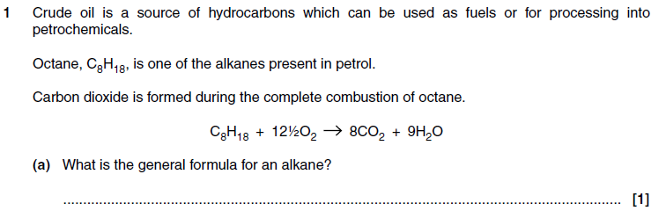
Examination question

Slide 18
Mark scheme

Slide 19
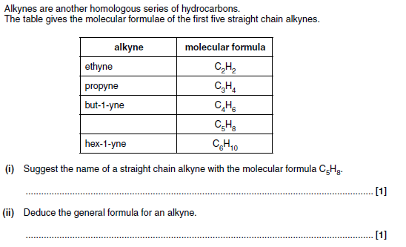
Examination question

Slide 20
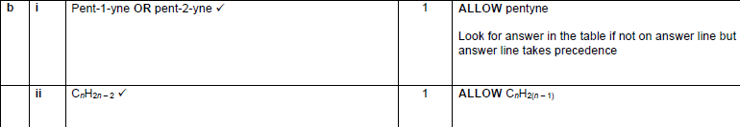
Mark scheme

Slide 21
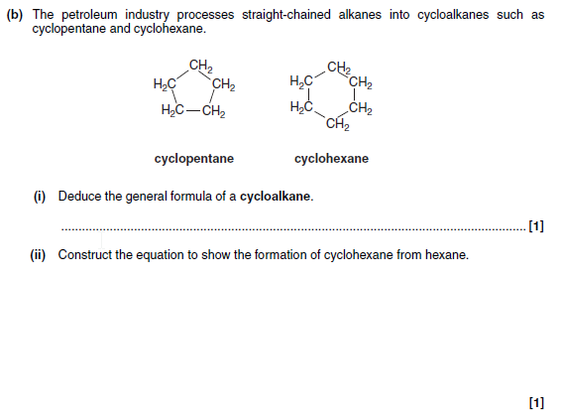
Examination question

Slide 22
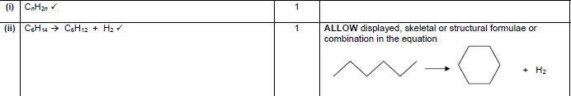
Mark scheme

Slide 23
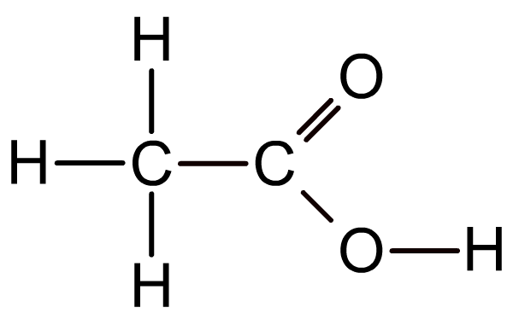
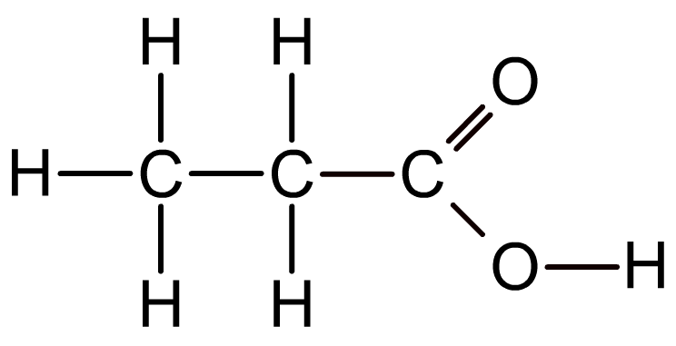
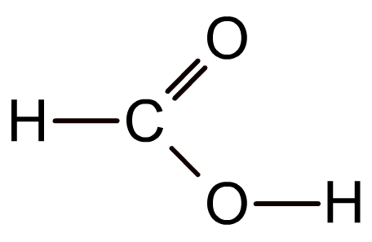
Functional groups and homologous series
A functional group is an atom or group of atoms responsible for the typical chemical reactions of a molecule.
A homologous series is a group of molecules with the same functional group but a different number of –CH₂ groups.
methanoic acid
(HCOOH)
ethanoic acid
(CH₃COOH)
propanoic acid
(CH₃CH₂COOH)
Functional groups determine the pattern of reactivity of a homologous series, whereas the carbon chain length determines physical properties such as melting/boiling points.

Slide 24
Naming compounds

Slide 25
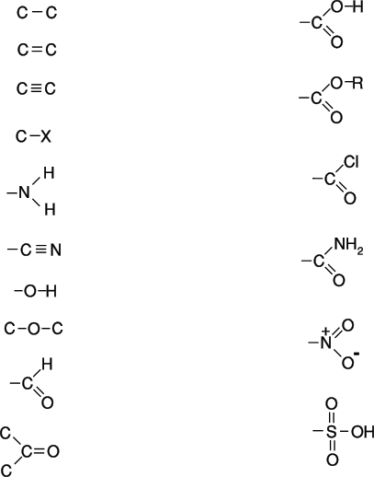
COMMON FUNCTIONAL GROUPS
ALKANE
ALKENE
ALKYNE
HALOALKANE
AMINE
NITRILE
ALCOHOL
ETHER
ALDEHYDE
KETONE
CARBOXYLIC ACID
ESTER
ACYL CHLORIDE
AMIDE
NITRO
SULPHONIC ACID

Slide 26
I.U.P.A.C. NOMENCLATURE
A systematic name has
STEM – This is the number of carbon atoms in longest chain bearing the functional group
PREFIX - This shows the position and identity of any side-chain substituents
SUFFIX - This shows the functional group is present
Number of C atoms stem name
1 meth-
2 eth-
3 prop-
4 but-
5 pent-
6 hex-
7 hept-
8 oct-
9 non-
10 dec-

Slide 27
Common prefixes
1-methyl 2-methyl 1-ethyl 2-ethyl
1-propyl 2-propyl 1-chloro 2-chloro
1-fluoro 2-fluoro chloro chlorofluoro
dichloro trichloro 1-amino 2-amino

Slide 28
Common suffixes
-ene alkene (double bond)
-yne alkyne (triple bond)
-oic acid carboxylic acid
-ol alcohol
-al aldehyde
-one ketone
-oyl chloride acyl chloride
-nitrile nitrile
-amide amide

Slide 29
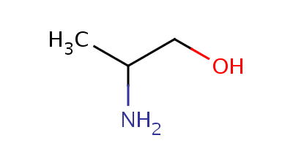
Putting it all together
Start with the stem “propan”
Add the functional group and its position “1-ol”
Add any substituent(s) and their position(s) “2-amino”
2-amino propan-1-ol

Slide 30
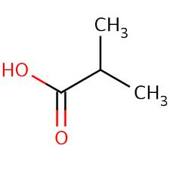
Putting it all together
Start with the stem
Add the functional group
Add any substituent(s) and their position(s)

Slide 31
Putting it all together
Start with the stem
“propan”
Add the functional group
“oic acid”
Add any substituent(s) and their position(s)
“2-methyl”
2-methyl propanoic acid

Slide 32
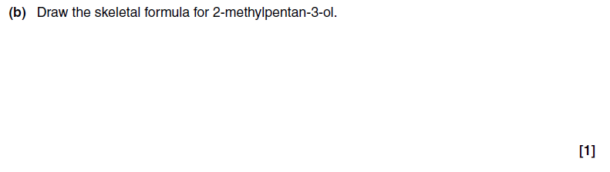
Examination questions

Slide 33

Mark scheme

Slide 34
Branching
Look at the structures and work out how many carbon atoms are in the longest chain.
CH₃
CH₃
CH₂
CH₃
CH₂
CH₂
CH₂
CH
CH₃
CH₃
CH
CH₂
CH₃
CH₃
CH₃
CH₂
CH₃
CH₂
CH
CH
CH₃

Slide 35
Answers
CH₃
CH₂
LONGEST CHAIN = 5
CH₃
CH
CH₂
CH₃
CH₃
LONGEST CHAIN = 6
CH₃
CH₂
CH₂
CH₂
CH
CH₃
CH₃
CH₃
CH₂
LONGEST CHAIN = 6
CH₃
CH₂
CH
CH
CH₃

Slide 36
NOMENCLATURE - rules
Rules - Summary
Number the principal chain from one end to give the lowest numbers.
Side-chain names appear in alphabetical order butyl, ethyl, methyl, propyl
Each side-chain is given its own number.
If identical side-chains appear more than once, prefix with di, tri, tetra, penta, hexa
Numbers are separated from names by a HYPHEN e.g. 2-methylheptane
Numbers are separated from numbers by a COMMA e.g. 2,3-dimethylbutane

Slide 37
Test your understanding
Apply the rules and name these alkanes
CH₃
CH₂
CH₃
CH
CH₂
CH₃
CH₃
CH₃
CH₂
CH₂
CH₂
CH
CH₃
CH₃
CH₃
CH₂
CH₃
CH₂
CH
CH
CH₃

Slide 38
Answers
Apply the rules and name these alkanes
CH₃
Longest chain = 5 - so it is a pentane stem.
CH₃, methyl, group is attached to the third carbon from one end...
3-methylpentane
CH₂
CH₃
CH
CH₂
CH₃
CH₃
Longest chain = 6 - so it is a hexane stem.
CH₃, methyl, group is attached to the second carbon from one end...
2-methylhexane
CH₃
CH₂
CH₂
CH₂
CH
CH₃
Longest chain = 6 - so it is a hexane stem,
CH₃, methyl, groups are attached to the third and fourth carbon atoms (whichever end you count from), so we use the prefix ‘di’…
3,4-dimethylhexane
CH₃
CH₃
CH₂
CH₃
CH₂
CH
CH
CH₃

Slide 39
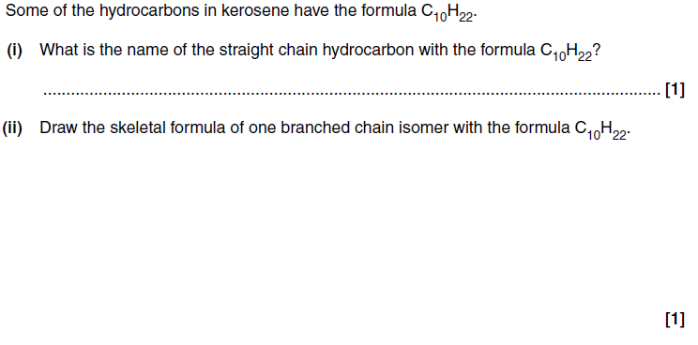
Examination questions

Slide 40

Mark scheme

Slide 41
Naming Alkenes
Suffix -ENE
Length In alkenes the principal chain is not always the longest chain
It must contain the double bond
Position Count from one end as with alkanes.
Indicated by the lower numbered carbon atom on one end of the C=C bond
5 4 3 2 1
CH₃CH₂CH=CHCH₃ is pent-2-ene (NOT pent-3-ene)
Side-chain Named similar to alkanes. The position is based on the number allocated to the double bond
1 2 3 4 1 2 3 4
CH₂ = CH(CH₃)CH₂CH₃ CH₂ = CHCH(CH₃)CH₃
2-methylbut-1-ene 3-methylbut-1-ene

Slide 42
Exam question
Q1. Draw the skeletal formula for 2-methylpentan-3-ol.
[Total 1 mark]

Slide 43
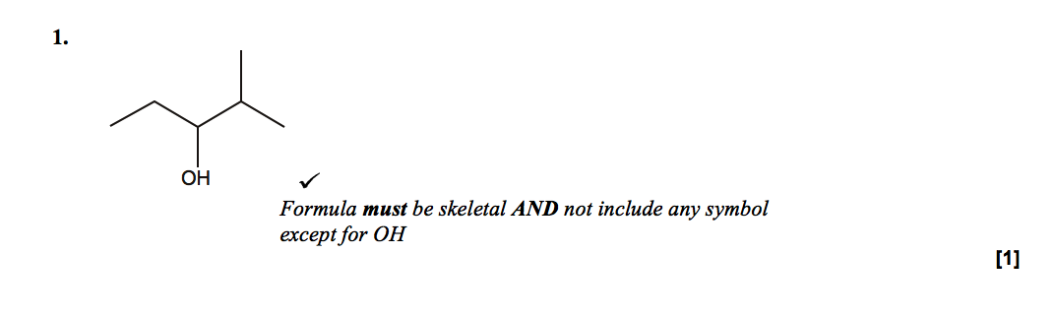
Mark scheme

Slide 44
Isomerism

Slide 45
Definitions
structural isomers are compounds with the same molecular formula but different structural formulae,
stereoisomers are compounds with the same structural formula but with a different arrangement in space,
E/Z isomerism is an example of stereoisomerism, arising from restricted rotation about a double bond. Two different groups must be attached to each carbon atom of the C=C group,
cis-trans isomerism are a special case of E/Z isomerism in which two of the substituent groups are the same;

Slide 46
What do I need to be able to do?
Determine the possible structural formulae and/or stereoisomers of an organic molecule, given its molecular formula.

Slide 47

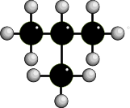
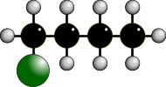




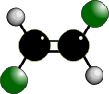
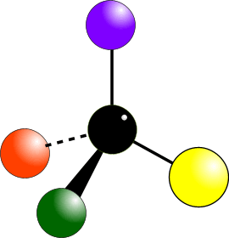
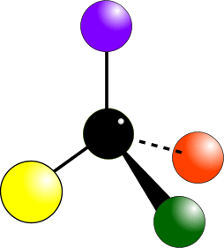
TYPES OF ISOMERISM
CHAIN ISOMERISM
STRUCTURAL ISOMERISM
POSITION ISOMERISM
Same molecular formula but different structural formulae
FUNCTIONAL GROUP ISOMERISM
E/Z ISOMERISM
Occurs due to the restricted rotation of C=C double bonds... two forms… E and Z (CIS and TRANS)
STEREOISOMERISM
Same molecular formula but atoms occupy different positions in space.
OPTICAL ISOMERISM
Occurs when molecules have a chiral centre. Get two non-superimposable mirror images.

Slide 48
Structural isomerism - chain
These are caused by different arrangements of the carbon skeleton. They have similar chemical properties
These have slightly different physical properties
Make the structural isomers of C₄H₁₀ .
BUTANE
2-METHYLPROPANE
- 0.5°C
straight chain
- 11.7°C
branched

Slide 49


Structural isomerism - positional
Each molecule has the same carbon skeleton.
Each molecule has the same functional group... BUT the functional group is in a different position
They have similar chemical properties
They have different physical properties
1
2
2
3
PENT-1-ENE
double bond between carbons 1 and 2
PENT-2-ENE
double bond between carbons 2 and 3

Slide 50




Structural isomerism - Functional group
Molecules have same molecular formula
Molecules have different functional groups
Molecules have different chemical properties
Molecules have different physical properties
ALCOHOLS and ETHERS
ALDEHYDES and KETONES
ACIDS and ESTERS

Slide 51
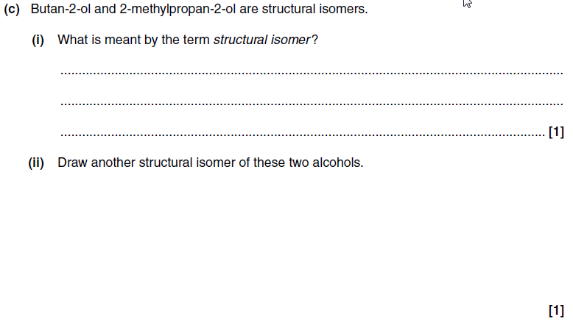
Examination questions

Slide 52
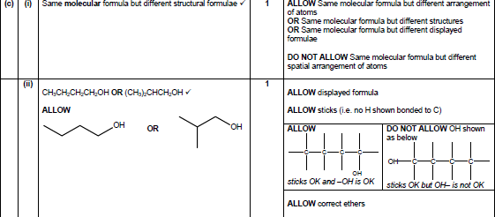
Mark scheme

Slide 53
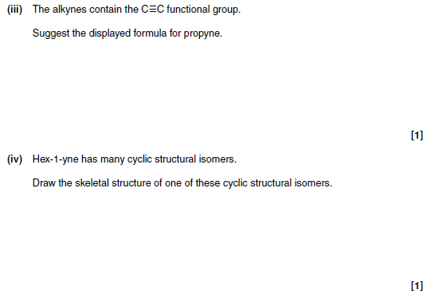
Examination question

Slide 54
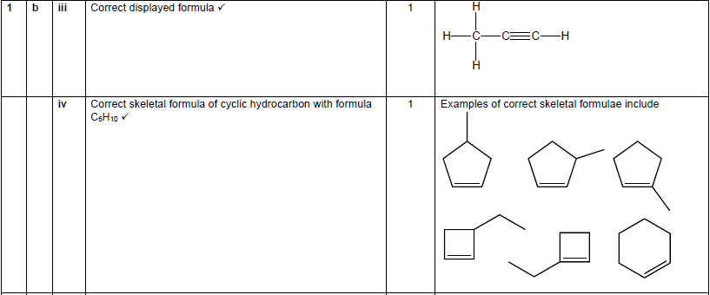
Mark scheme

Slide 55
Stereoisomerism
Molecules have the same molecular formula but the atoms are joined to each other in a different spacial arrangement - they occupy a different position in 3-dimensional space.
There are two types...
• E/Z isomerism
• Optical isomerism

Slide 56
E/Z isomerism
These are found in some, but not all, alkenes
These isomers occurs due to the lack of rotation of the carbon-carbon double bond (C=C bonds)
Z
Groups/atoms are on the
SAME SIDE of the double bond
E
Groups/atoms are on OPPOSITE SIDES across the double bond
CIS and TRANS are a special case of E/Z where the groups on each side of the double bond are the same

Slide 57
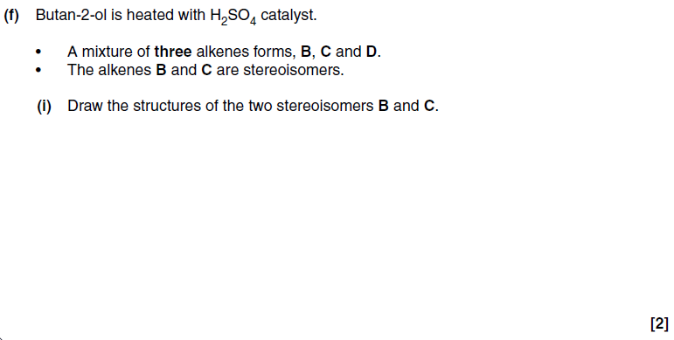
Examination question

Slide 58

Mark scheme

Slide 59
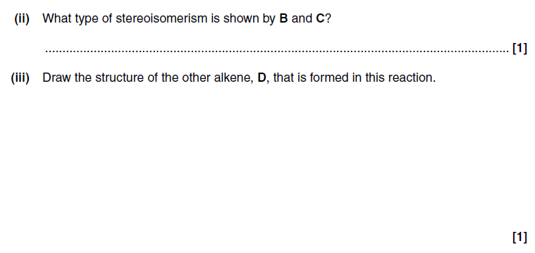
Examination question

Slide 60
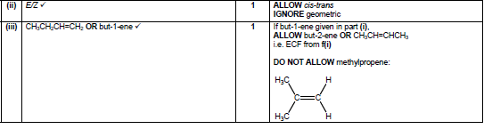
Mark scheme

Slide 61
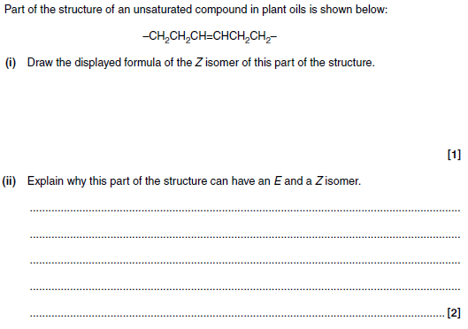
Examination question

Slide 62
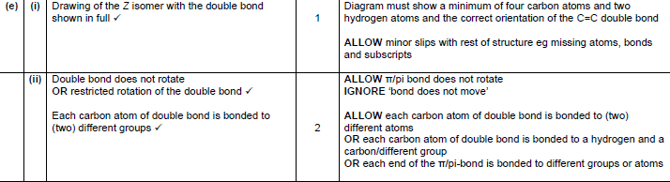
Mark scheme

Slide 63
Optical isomerism
These occur when compounds have non-superimposable mirror images
The two different forms are known as optical isomers or enantiomers. They occur when molecules have a chiral centre.
A chiral centre contains an asymmetric carbon atom. An asymmetric carbon has four different atoms (or groups) arranged tetrahedrally around it.

Slide 64
Chiral centres
1
1
4
4
2
2
3
3
There are four different colours arranged tetrahedrally about the carbon atom.

Slide 65
Percentage yield and atom economy

Slide 66
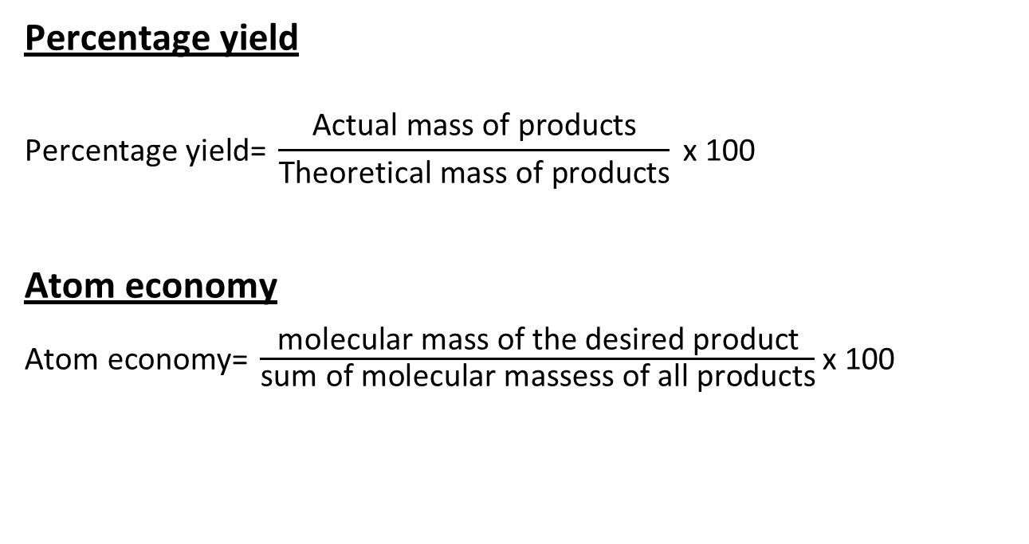
Definitions
Percentage yield
Atom economy
x 100

Slide 67
You need to be able to…
explain that addition reactions have an atom economy of 100%, whereas substitution reactions are less efficient
describe the benefits of developing chemical processes with a high atom economy in terms of fewer waste materials
explain that a reaction may have a high percentage yield but a low atom economy

Slide 68
Percentage yield calculations
1. When calcium carbonate is heated fiercely it decomposes to form calcium oxide and carbon dioxide.
CaCO₃(s) → CaO(s) + CO₂(g)
5.00 g of calcium carbonate produced 2.50 g of calcium oxide. What is the percentage yield of this reaction?
2. Potassium chloride is made by the reaction between potassium and chlorine.
2K(s) + Cl₂(g) → 2KCl(s)
4.00 g of potassium produced 7.20 g of potassium chloride. What is the percentage yield of this reaction?
3. When potassium chlorate is heated strongly it decomposes to produce potassium chloride and oxygen.
2KClO₃(s) → 2KCl(s) + 3O₂(g)
Heating 3.00 g of potassium chlorate produced 1.60 g of potassium chloride. What is the percentage yield of this reaction?

Slide 69
Test your knowledge - answers
1. When calcium carbonate is heated fiercely it decomposes to form calcium oxide and carbon dioxide.
CaCO₃(s) → CaO(s) + CO₂(g)
5.00 g of calcium carbonate produced 2.50 g of calcium oxide. What is the percentage yield of this reaction?
89.3%
2. Potassium chloride is made by the reaction between potassium and chlorine.
2K(s) + Cl₂(g) → 2KCl(s)
4.00 g of potassium produced 7.20 g of potassium chloride. What is the percentage yield of this reaction?
94.2%
3. When potassium chlorate is heated strongly it decomposes to produce potassium chloride and oxygen.
2KClO₃(s) → 2KCl(s) + 3O₂(g)
Heating 3.00 g of potassium chlorate produced 1.60 g of potassium chloride. What is the percentage yield of this reaction?
87.9%

Slide 70
Atom economy
In most reactions you only want to make one of the resulting products
Atom economy is a measure of how much of the products are useful
A high atom economy means that there is less waste this means the process is MORE SUSTAINABLE.

Slide 71
Atom economy calculations
Calculate the atom economy for the formation of nitrobenzene, C₆H₅NO₂
Equation C₆H₆ + HNO₃ → C₆H₅NO₂ + H₂O
M_{r} 78 63 123 18
Atom economy = molecular mass of C₆H₅NO₂ x 100
molecular mass of all products
= 123 x 100 = 87.2%
123 + 18
An ATOM ECONOMY of 100% is not possible with a SUBSTITUTION REACTION like this

Slide 72
Atom economy - calculations
Calculate the atom economy for the preparation of ammonia from the thermal decomposition of ammonium sulphate.
Equation (NH₄)₂SO₄ → H₂SO₄ + 2NH₃
M_{r} 132 98 17
Atom economy = 2 x molecular mass of NH₃ x 100
molecular mass of all products
= 2 x 17 = 25.8%
98 + (2 x 17)
In industry a low ATOM ECONOMY isn’t necessarily that bad if you can use some of the other products. If this reaction was used industrially, which it isn’t, the sulphuric acid would be a very useful by-product.

Slide 73
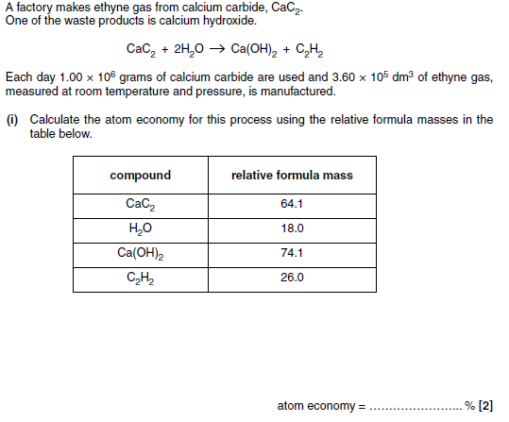
Examination question

Slide 74
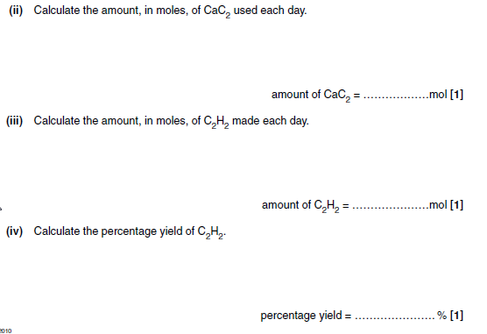

Slide 75
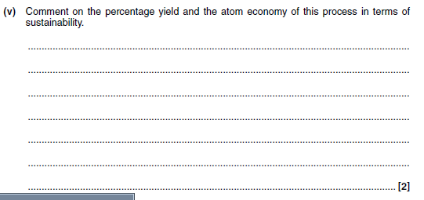

Slide 76
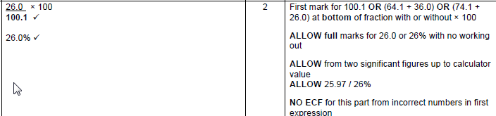
Mark scheme

Slide 77
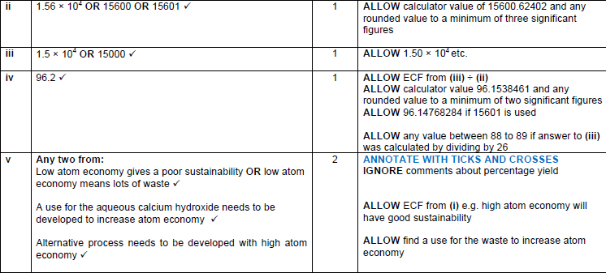

Slide 78
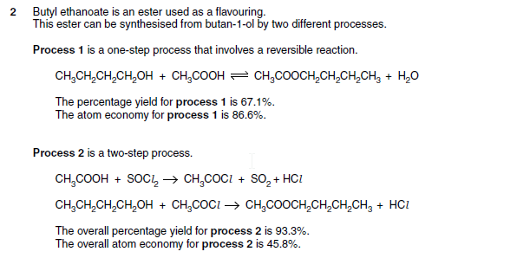
Examination question

Slide 79
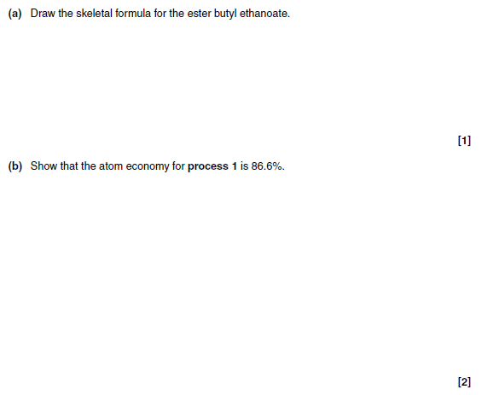

Slide 80
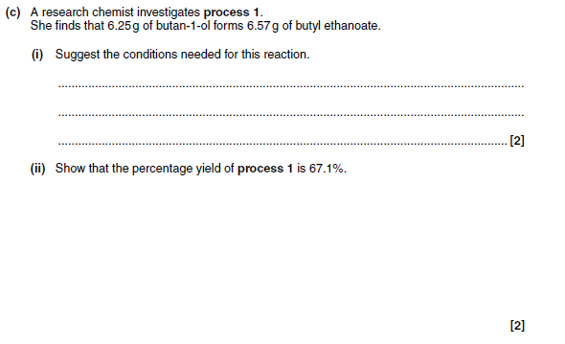

Slide 81
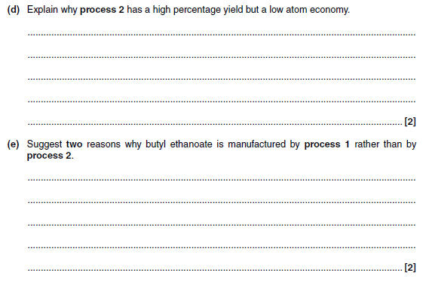

Slide 82
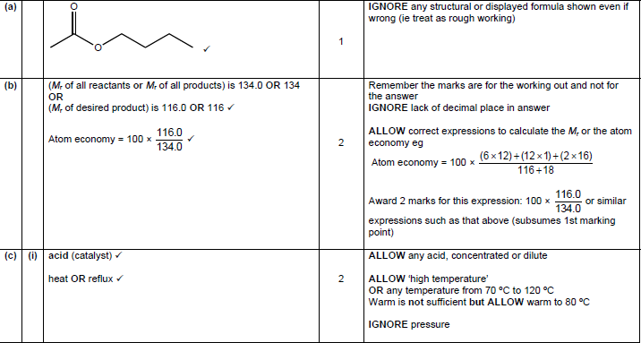
Mark scheme

Slide 83


Slide 84


Slide 85
Crude oil

Slide 86
Definitions
A hydrocarbon is a compound of hydrogen and carbon only
Crude oil is a source of hydrocarbons, separated as fractions with different boiling points by fractional distillation, which can be used as fuels or for processing into petrochemicals
Alkanes and cycloalkanes are saturated hydrocarbons which have only single bonds between carbon atoms. Unsaturated carbon atoms have at least one carbon-carbon double bond.
There is a tetrahedral shape around each carbon atom in alkanes (this is called sp3 hybridised).

Slide 87
You need to be able to…
Explain, in terms of Van der Waals’ forces, the variations in the boiling points of alkanes with different carbon-chain length and branching;
Describe the complete combustion of alkanes, leading to their use as fuels in industry, in the home and in transport
Explain, using equations, the incomplete combustion of alkanes in a limited supply of oxygen and outline the potential dangers arising from production of CO in the home and from car use

Slide 88

Shapes of carbon compounds
In alkanes, bonds from carbon atoms are arranged tetrahedrally.
Carbon - has four outer electrons, therefore forms four covalent bonds
H
H
C
H
H
BOND PAIRS 4
BOND ANGLE... 109.5° SHAPE... TETRAHEDRAL

Slide 89

Examination questions

Slide 90

Mark scheme

Slide 91

Crude oil and alkanes
Crude oil is a mixture composed mainly of straight and branched chain alkanes.
It also includes lesser amounts of cycloalkanes and arenes, both of which are hydrocarbons containing a ring of carbon atoms, as well as impurities such as sulfur compounds.
The exact composition of crude oil depends on the conditions under which it formed, so crude oil extracted at different locations has different compositions.

Slide 92


Slide 93
Key points for exam questions
To explain fractional distillation
Heat crude oil to make it a gas/vapour it rises up the column.
Lighter hydrocarbons travel further up the column.
Hydrocarbons condense at different temperatures (boiling points).
The higher the molecular weight the higher its boiling point (due to stronger Van der Waal’s forces).

Slide 94
Exam question
Kerosene is used as a fuel for aeroplane engines.
Kerosene is obtained from crude oil.
Name the process used to obtain kerosene from crude oil and explain why the process works.
..........................................................................................
..........................................................................................
..........................................................................................
[Total 2 marks]

Slide 95
Mark scheme
Fractional distillation
DO NOT ALLOW just ‘distillation’
Because fractions have different boiling points
For fractions,
ALLOW components OR hydrocarbons OR compounds
ALLOW condense at different temperatures
ALLOW because van der Waals’ forces differ between molecules
IGNORE reference to melting points
IGNORE ‘crude oil’ OR ‘mixture’ has different boiling points’
……… but ALLOW ‘separates crude oil by boiling points
[2]

Slide 96

Examination question

Slide 97

Mark scheme

Slide 98
Shapes of molecules and Van der Waals forces
C
C
Greater contact between linear butane molecules
→ STRONGER Van der Waal forces
→ HIGHER boiling point
C
C
C
C
C
C
C
C
Less contact between branched methylpropane molecules
→ WEAKER Van der Waal forces
→ LOWER boiling point
C
C
C
C
C
C

Slide 99
Summary - trends in boiling points
The boiling point of straight-chain alkanes increases with chain length.
Branched-chain alkanes have lower boiling points.

Slide 100

Combustion
Complete combustion occurs when there is enough oxygen – for example when the hole is open on a Bunsen burner.
The products of complete combustion are carbon dioxide and water.
CH₄ + 2O₂ → CO₂ + 2H₂O

Slide 101


AfL - Complete combustion

Slide 102
Incomplete combustion
Incomplete combustion occurs when there is not enough oxygen – for example when the hole is closed on a Bunsen burner.
The products of incomplete combustion include carbon monoxide and carbon (soot). It is often called a sooty flame.
This is the equation for the incomplete combustion of propane
2C₃H8 + 7O₂ → 2C + 2CO + 2CO₂ + 8H₂O

Slide 103

AfL – incomplete combustion

Slide 104
Problems arising from burning fuels
There are a number of key pollutants arising from burning fossil fuels

Slide 105
Carbon dioxide
Carbon dioxide is a greenhouse gas.
This means it causes global warming by absorbing infrared radiation from the surface of the Earth trapping heat from the sun within the Earth’s atmosphere.

Slide 106
Carbon monoxide
Carbon monoxide is an odourless and tasteless poisonous gas.
It is formed due to the incomplete combustion of hydrocarbons from crude oil such as petrol or diesel or domestic gas.
If produced in an enclosed space it can be deadly.

Slide 107
Soot/smoke particles
Particles of carbon from incomplete combustion can be released into the atmosphere.
This contributes to GLOBAL DIMMING

Slide 108
Other pollutants
Sulphur present in fuels burns to produce sulphur dioxide.
At high temperatures oxides of nitrogen may also be formed from nitrogen in the atmosphere.
These react with water in the atmosphere to form ACID RAIN

Slide 109

Acid rain

Slide 110

Cleaning up
Undesirable combustion products can be cleaned from emissions before they leave the chimney by using a filter or catalytic converter (cars).

Slide 111
Sustainability
Contrast the value of fossil fuels for providing energy and raw materials with;
(i) the problem of an over-reliance on non-renewable fossil fuel reserves and the importance of developing renewable plant based fuels, ie alcohols and biodiesel
(ii) increased CO₂ levels from combustion of fossil fuels leading to global warming and climate change

Slide 112
Biofuels

Slide 113

The problem with crude
Crude oil is a limited resource that will eventually run out.
Alternatives are needed and some are already under development.

Slide 114
Ethical and environmental issues
Clearance of rainforests to plant fuel crops
Using land formerly used for food crop (causing hardship)
Not replacing crops with sufficient crops after harvest for the process to remain carbon neutral
Erosion – replacing trees with crops with shallow roots

Slide 115
Carbon neutral
Plants photosynthesise using carbon (dioxide) from the air
Biodiesel/bioethanol releases carbon (dioxide) from plants
Plants are replanted and photosynthesise, removing the carbon (dioxide) again.
(fossil) diesel from crude oil releases ‘locked up’ carbon (dioxide) and doesn’t absorb any CO₂

Slide 116
Carbon neutral… or not?
Energy needed for processing biofuels and transporting is not offset by photosynthesis so is not completely carbon neutral.

Slide 117

Examination question

Slide 118

Mark scheme

Slide 119

Examination question

Slide 120

Mark scheme

Slide 121
Different types of biofuels
Ethanol – produced by fermentation of sugars in sugarcane
Biodiesel – produced from hydrolysis of vegetable oils

Slide 122
How do we make ethanol?
Fermentation is a key process for obtaining ethanol. It is relatively cheap and requires wheat or beet sugar.
The process involves the anaerobic respiration of yeast at temperatures between 20 and 40°C and at pH 7.

Slide 123

Conditions for fermentation
Why is temperature important?
Outside an optimum temperature the yeast does not work (high temperatures kill the yeast).
Why do you think pH is important?
Outside an optimum pH the yeast does not work (extremes of pH kill the yeast).
Why do you think it is important to shut out oxygen?
To make ethanol the yeast must respire anaerobically (without oxygen).
What effect will increasing ethanol concentration have on the yeast?
Eventually the ethanol concentration will be too high for the fermentation to continue. This means only a dilute solution can be made.

Slide 124

Example question

Slide 125
Mark scheme

Slide 126

Example question

Slide 127

Mark scheme

Slide 128

Example question

Slide 129

Mark scheme

Slide 130

How do we obtain a concentrated solution?
Ethanol has a different boiling point to water. We can therefore separate water and ethanol using distillation.

Slide 131

Example question

Slide 132

Mark scheme

Slide 133

Examination question

Slide 134

Mark scheme

Slide 135

Examination question

Slide 136

Examination question

Slide 137

Mark scheme

Slide 138
Catalytic Cracking

Slide 139
You need to be able to:
Describe the use of catalytic cracking to obtain more useful alkanes and alkenes;
Explain that the petroleum industry processes straight-chain hydrocarbons into branched alkanes and cyclic hydrocarbons to promote efficient combustion and prevent ‘knocking’;

Slide 140

Examination question

Slide 141

Mark scheme
Tip: This answer on more efficient combustion (reduced knocking) is useful for branched chains too

Slide 142
What is cracking?
Cracking is a process that splits long chain alkanes into shorter chain alkanes, alkenes and hydrogen.
C₁₀H₂₂ → C₇H₁₆ + C₃H₆
Cracking has the following uses:
it increases the amount of gasoline and other economically important fractions
it increases branching in chains, an important factor improving combustion in petrol
it produces alkenes, an important feedstock for chemicals.
There are two main types of cracking: thermal and catalytic.

Slide 144
Cracking
(a) Thermal Cracking
(b) Catalytic Cracking
Large alkane mols treated at
≈ 700 – 1200K
and ≈ 7000 kPa
for ≈ 0.5 seconds
Large alkane mols treated at
      700K
and slight pressure
using a ZEOLITE CATALYST
(= Al₂O₃ + SiO₂)
Produces high % of alkenes,
+ some smaller alkane mols,
+ some H₂(g)
Produces branched alkanes
+ cyclohexane (C₆H₁₂)
+ benzene (C₆H₆)
+ some H₂(g)
Alkenes = raw materials for polymers etc
Branched alkanes = more efficient fuels
Benzene = raw material for plastics, drugs, dyes, explosives etc

Slide 145
Thermal vs. catalytic cracking
List the advantages catalytic cracking has over thermal cracking:
it produces a higher proportion of branched alkanes, which burn more easily than straight-chain alkanes and are therefore an important component of petrol
the use of a lower temperature and pressure mean it is cheaper
it produces a higher proportion of arenes, which are valuable feedstock chemicals.
However, unlike thermal cracking, catalytic cracking cannot be used on all fractions, such as bitumen, the supply of which outstrips its demand.

Slide 146
Radicals

Slide 147
Definitions
Radical - a species with an unpaired electron
Homolytic fission is where two radicals are formed when a bond splits evenly and each atom gets one of the two electrons.
Heterolytic fission is where both electrons from a bond go to one of the atoms to form a cation and an anion;
A ‘curly arrow’ represents the movement of an electron pair, showing either breaking or formation of a covalent bond;

Slide 148
You need to be able to…
Outline reaction mechanisms, using diagrams, to show clearly the movement of an electron pair with ‘curly arrows’;
Describe the substitution of alkanes using ultraviolet radiation, by Cl₂ and by Br₂, to form halogenoalkanes;
Describe how homolytic fission leads to the mechanism of radical substitution in alkanes in terms of initiation, propagation and termination reactions (see also 2.1.1.h);
Explain the limitations of radical substitution in synthesis, arising from further substitution with formation of a mixture of products.

Slide 149
Chlorination of methane
Initiation
During initiation the Cl-Cl bond is broken in preference to the others as it is requires less energy to separate the atoms.
Cl₂ → 2Cl• radicals created – the single dots represent unpaired electrons
Propagation
Free radicals are very reactive because they want to pair up their single electron.
Cl• + CH₄ → CH₃• + HCl
radicals used are regenerated ‘propagating’ the reaction
Cl₂ + CH₃• → CH₃Cl + Cl•
Termination
Cl• + CH₃• → CH₃Cl
As two radicals react together they are removed
This is unlikely at the start because of their low concentration
Cl• + Cl• → Cl₂
CH₃• + CH₃• → C₂H₆

Slide 150
Free radicals - summary
reactive species (atoms or groups) which possess an unpaired electron
They react in order to pair up the single electron
formed by homolytic fission of covalent bonds
formed during the reaction between chlorine and methane (UV)
formed during thermal cracking
involved in the reactions taking place in the ozone layer

Slide 151


Other products of chain reactions
If an alkane is more than two carbons in length then any of the hydrogen atoms may be substituted, leading to a mixture of different isomers. For example:
1-chloropropane
2-chloropropane
The mixture of products is difficult to separate, and this is one reason why chain reactions are not a good method of preparing halogenoalkanes.

Slide 152




Further substitution in chain reactions
Further substitution can occur until all hydrogens are substituted.
→
→
→
The further substituted chloroalkanes are impurities that must be removed. The amount of these molecules can be decreased by reducing the proportion of chlorine in the reaction mixture. It is another reason why this method of preparing chloroalkanes is unreliable.
Different products can be separated by fractional distillation

Slide 153

Examination question

Slide 154

Mark scheme

Slide 155
Exam question
Cyclohexane, C₆H₁₂, reacts with chlorine to produce chlorocyclohexane, C₆H₁₁Cl.
C₆H₁₂ + Cl₂ → C₆H₁₁Cl + HCl
The mechanism for this reaction is a free radical substitution.
(i) Write an equation to show the initiation step.
  .........................................................................................................................[1]
(ii) State the conditions necessary for the initiation step.
  .........................................................................................................................[1]
(iii) The reaction continues by two propagation steps resulting in the formation of chlorocyclohexane, C₆H₁₁Cl .
  Write equations for these two propagation steps.
  step 1 ..............................................................................................................
  step 2 ..............................................................................................................[2]
(iv) State what happens to the free radicals in the termination steps.
  .........................................................................................................................[1]
[Total 5 marks]

Slide 156
Mark scheme
(i) Cl₂ → 2Cl·
(ii)uv (light)/high temperature/min of 400ºC/ sunlight
(iii) Cl· + C₆H₁₂ → C₆H₁₁· + HCl
C₆H₁₁· + Cl₂ → C₆H₁₁Cl + Cl·
(iv) react with each other/suitable equation

Slide 157
Alkenes and addition reactions

Slide 158
Definitions
Alkenes and cycloalkenes are unsaturated hydrocarbons;
The double bond is formed from overlap of adjacent p-orbitals to form a π bond.
There is a trigonal planar shape around each carbon in the C=C of alkenes (this is called sp2 hybridised)
An electrophile is an electron pair acceptor

Slide 159
You need to be able to…
Describe, including mechanism, addition reactions of alkenes,
hydrogen in the presence of a suitable catalyst, ie Ni, to form alkanes,
halogens to form dihalogenoalkanes, including the use of bromine to detect the presence of a double C=C bond as a test for unsaturation,
hydrogen halides to form halogenoalkanes,
steam in the presence of an acid catalyst to form alcohols

Slide 160


The bond angle around C=C is 120 degrees due to the overlap of the p-orbitals.
The shape is described as trigonal planar.
The π bond is weaker than a σ bond so the bond energy is less than twice a single bond.

Slide 161


Slide 162

Mark scheme

Slide 163

Examination question

Slide 164

Mark scheme

Slide 165
Hydrogenation
Hydrogen can be added to the carbon–carbon double bond in a process called hydrogenation.
C₂H₄ + H₂ → C₂H₆
Nickel catalyst,
Temperature 200 °C
Pressure 1000 kPa.
Vegetable oils are unsaturated and may be hydrogenated to make margarine.

Slide 166

Examination question

Slide 167
Mark scheme

Slide 168
Double bonds and electrophiles
The double bond of an alkene is an area of high electron density, and therefore an area of high negative charge.
The negative charge of the double bond may be attacked by electron-deficient species, which will accept a lone pair of electrons.
These species have either a full positive charge or slight positive charge on one or more of their atoms. They are called electrophiles, meaning ‘electron loving’. An electrophile is an electron pair acceptor.
Alkenes undergo addition reactions when attacked by electrophiles. This is called electrophilic addition.

Slide 169


Electrophilic Addition Mechanism
In this step, a pair of electrons from the double bond forms a co-ordinate covalent bond with A. The A—B bond breaks to release anion B. Notice that a positively charged intermediate, carbocation is formed in this step.
In the final step, a lone pair of electrons in B ion forms a co-ordinate covalent bond with the positively charged intermediate.

Slide 170

Examiners’ tips
The complete reaction mechanism, with ticks to show the features an examiner is likely to look for in an examination.
Make sure the curly arrow starts touching a bond and ends where the electrons will be (a bond or atom).

Slide 171

Examination question

Slide 172


Slide 173

Test for Alkenes
Alkenes DECOLORISE bromine water.
When you add bromine water to an alkene it turns colourless.

Slide 174

Test for alkenes

Slide 175
Reaction with alkenes and bromine
A simple equation for the bromine water test with ethene is:
CH₂=CH₂ + Br₂ + H₂O → CH₂BrCH₂Br + H₂O
However, because water is present in such a large amount, a water molecule (which has a lone pair) adds to one of the carbon atoms, followed by the loss of a H⁺ ion.
CH₂=CH₂ + Br₂ + H₂O → CH₂BrCH₂OH + HBr
The major product of the test is not 1,2-dibromoethane (CH₂BrCH₂Br) but 2-bromoethan-1-ol (CH₂BrCH₂OH).

Slide 176

Past paper questions

Slide 177

Mark scheme

Slide 178

Steam hydrogenation of ethene to make ethanol
React with steam at 320ºC.
Phosphoric acid (conc.) (H₃PO₄) catalyst

Slide 179



Addition to unsymmetrical alkenes
+ HBr
minor product:
1-bromopropane
major product:
2-bromopropane
Unequal amounts of each product are formed due to the relative stabilities of the carbocation intermediates.

Slide 180



Stability of carbocations
The stability of carbocations increases as the number of alkyl groups on the positively-charged carbon atom increases.
primary
secondary
tertiary
increasing stability
The stability increases because alkyl groups contain a greater electron density than hydrogen atoms. This density is attracted towards, and reduces, the positive charge on the carbon atom, which has a stabilizing effect.

Slide 181
Polymerisation

Slide 182
You need to be able to…
Describe the addition polymerisation of alkenes;
Deduce the repeat unit of an addition polymer obtained from a given monomer;
Identify the monomer that would produce a given section of an addition polymer;
Outline the use of alkenes in the industrial production of organic compounds:
  the manufacture of margarine by catalytic hydrogenation of unsaturated vegetable oils using hydrogen and a nickel catalyst,
  the formation of a range of polymers using unsaturated monomer units based on the ethene molecule, ie H₂C=CHCl, F₂C=CF₂

Slide 183




Addition polymers are named after the monomer used to make them:
is prepared from
poly(ethene)
ethene
is prepared from
poly(propenenitrile)
propenenitrile

Slide 184
Addition polymerisation
Free radical process involve high pressure, high temperature and a catalyst.
The catalyst is usually a substance (e.g. an organic peroxide) which readily breaks up to form radicals which initiate a chain reaction.
Another catalyst is a Ziegler-Natta catalyst (named after the scientists who developed it). Such catalysts are based on the compound TiCl₄.

Slide 185




initiation stage
propagation stage
termination stage

Slide 186

EXAMPLES OF ADDITION POLYMERISATION
ETHENE
POLY(ETHENE)
PROPENE
POLY(PROPENE)
CHLOROETHENE
POLY(CHLOROETHENE)
POLYVINYLCHLORIDE PVC
TETRAFLUOROETHENE
POLY(TETRAFLUOROETHENE)
PTFE “Teflon”

Slide 187

Draw the monomer

Slide 188

Draw the monomer

Slide 189

Draw the monomer

Slide 190




Which of these equations correctly shows how the monomer ethene becomes the polymer poly(ethene)?
A
B
C
D

Slide 191

Draw the MONOMER

Slide 192





ANSWERS

Slide 193
Exam question
Q1. Fluoroalkenes are used to make polymers. For example, PVF, (CH₂CHF)_{n}, is used to make non-flammable interiors of aircraft.
(i) Draw two repeat units of the polymer PVF showing all bonds.
[1]
(ii) Draw the structure of the monomer of PVF.
[1]
[Total 2 marks]
Q2. But-1-ene can undergo polymerisation. Draw a section of the polymer that can be formed from but-1-ene. Show two repeat units.
[Total 2 marks]

Slide 194

Mark scheme
1. (i)
Free bonds at bond ends must be present
ALLOW minor slip e.g. missing one hydrogen and left as a stick
ALLOW more than two repeat units but must be a whole number of repeat units
IGNORE brackets, use of numbers and n in the drawn structure
1

Slide 195
Mark scheme
(ii)
ALLOW skeletal formula
ALLOW CH₂CHF

Slide 196

Mark scheme
2.
1 mark is available if the backbone consists of 4 C atoms and a reasonable attempt has been made
[2]

Slide 197

Examination question

Slide 198

Mark scheme

